Slide 1

Estate Radar
Just look, no more fuss….
Project made by:
Team Leader:
Daniil Rolnik
Team:
Eden Dupont
Ibrahim Hirzalla
Hasan Bader

Slide 2

Find the estate of your dreams with only a few clicks...

Slide 3
Current State
Today most people in Israel use Yad2 or Facebook groups to look for real estates.
Yad2 provides a non-intuitive, primitive user experience according to 2018’s standards, flooded with ads and popup windows*.
To successfully find a good real estate on Facebook you should find and join many groups and look in each and everyone of them for real estates that might interest you, and you may see many duplicates of the same listings.
Facebook’s interface is not optimal to look for real estate, and Yad2 is bulky and it’s really hard to find what you’re looking for.
Our aim is to provide an easy and intuitive solution to these problems.
*Ads are not an issue, it can be an important monetization option. But on Yad2 popups and banners are an obstacle to the user.

Slide 4
In Scope
Out of Scope
The website revolves around a map, which visualizes listings of estates for rent/sale alongside a list of estates in the area in focus.
The system allows potential buyers, to easily view listings that fit their needs on the map, and connects with the relevant estate owner.
For an estate owner interested to sell/rent their estate to another person, our website allows them to create a new listing.
For a real estate agent, the system allows them to create new listings (with a monthly fee), and help the agent’s potential clients easily view listings.
Payments between users are made outside of the system
Removing and archiving inactive listings
Viewing points of interest around the estate on the map (gym, supermarket, cinema, mall, hospital, bus station etc.)
Storing information on how users interact with my service (where they click, what pages they visit, where they stay the most)
Show information about nearby estates (average prices, average time to sell)
Service promotion
Notes:
Storing information - ניתוח התנהגות משתמש

Slide 5
Vision
Our vision is to be the most comfortable and most popular online service to search for real estates and to have the biggest database of estates for sell/rent in Israel and make a great impact on the estates market.

Slide 6
Project objectives/success criteria
Goal | Objectives | Success Criteria
Becoming a reliable resource | Providing quality listings, new listings added regularly | 90% positive user Feedback. Have more new listings per day than our competitors. *Estate Radar listings will be the first site in google searches results in Israel. Goals to be met within 2 years.
Build our brand | Active social media program, promotions, reputation management. | **At least 50,000 followers on every social network within 3 years. Get 30% of our followers to ‘like’/comment on each new post on our social medias after this time frame.
Profitable service | To make the service profitable | Initial profits should be gained one year after launch (at most), and the following years profits should exceed 100,000 ILS
*SEO (Search Engine Optimization) professional needed
**SMM (Social Media Marketing) professional needed

Slide 7
Stakeholders

Slide 8
Name | Internal/ External | Description | Goal | Connection to the project | Supportive/ Opposed
Customer | External | Wants the business to provide them with a good product. | Sell an estate quickly, or find an estate to rent/buy easily | User that is trying to gain from our site | Supportive
Creditors | External | Loaned money to the project | Their objective is to get their loan returned with interest. | No direct connection. | Supportive
Employees | Internal | Anyone who contributes work to the project with a salary or payment. | Job satisfaction, salary, job security, motivation and self-actualization. | Perform tasks the manager orders them to do. | Supportive
Government | External | Politicians, regulatory authorities | Get taxes, everything should be according to the law. Interested in new jobs for its citizens. | Regulator agent checks that the business meets the terms of the law | Support
Owners | Internal | People who own the company, may be investors | Interested in how much profit the business makes to get profits. | Owner, may make direct decisions. | Supportive
Competitors | External | Companies that provide similar services | Wants to get the biggest share of visitors. | Influences our site’s traffic, profits and the decisions we make. | Opposed
Notes:
Government מעוניין שנצליח, נעשה מקומות עבודה ונשלם מסים
רשויות מפקחות

Slide 9
Non-functional Requirements
Requirement Name and description | Requirement Type (U/R/P/S) (Usability/Reliability/Performance/ Supportability)
Load Map with all system details in under 10 sec for 10 mbps internet connection | Performance
Secure third party payment system meeting the standards of ISO 8583 | Reliability
Interface that lets a new user sign up in less than 3 minutes | Usability
Interface that lets user to add a new listing in less than 2 minutes | Usability
Site should be available 24/7 | Reliability

Slide 10
Non-functional Requirements
Requirement Name and description | Requirement Type (U/R/P/S) (Usability/Reliability/Performance/ Supportability)
User authentication shall be via the corporate Single Sign On system | Supportability
Localizability - It should be easy to add another languages | Supportability
Hebrew/Arabic/English/Russian localisations | Usability
To publish new listing is free for Buyer/Seller | Usability
To publish new listing is non free (one time fee) for realtor agent | Usability
Moderator will validate listing published on hours 08:00 - 24:00 (Jerusalem Time) in less than 30 min. | Reliability
Moderator will validate listing published on hours 24:00 - 08:00 (Jerusalem Time) before 08:30. | Reliability

Slide 11
Sources of profit
Native advertisements on the website (Subtle on the website, and more suitable to the site's design compared to yad2 for example).
Payment for Featured listing(to be on the top of the list) for sellers/agents.
- Agents pay for each listing they publish and receive the featured listing functionality on their listing automatically.
- Seller pays for featuring the listing of their choice (they may have non-featured listings already)

Slide 12
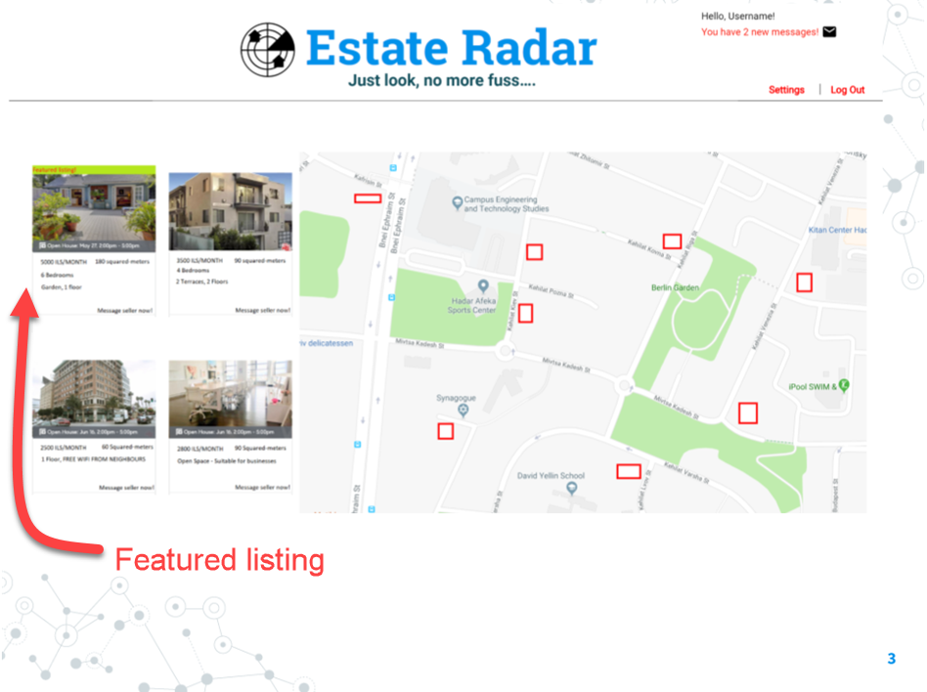

Slide 13
Kanban board

Slide 14
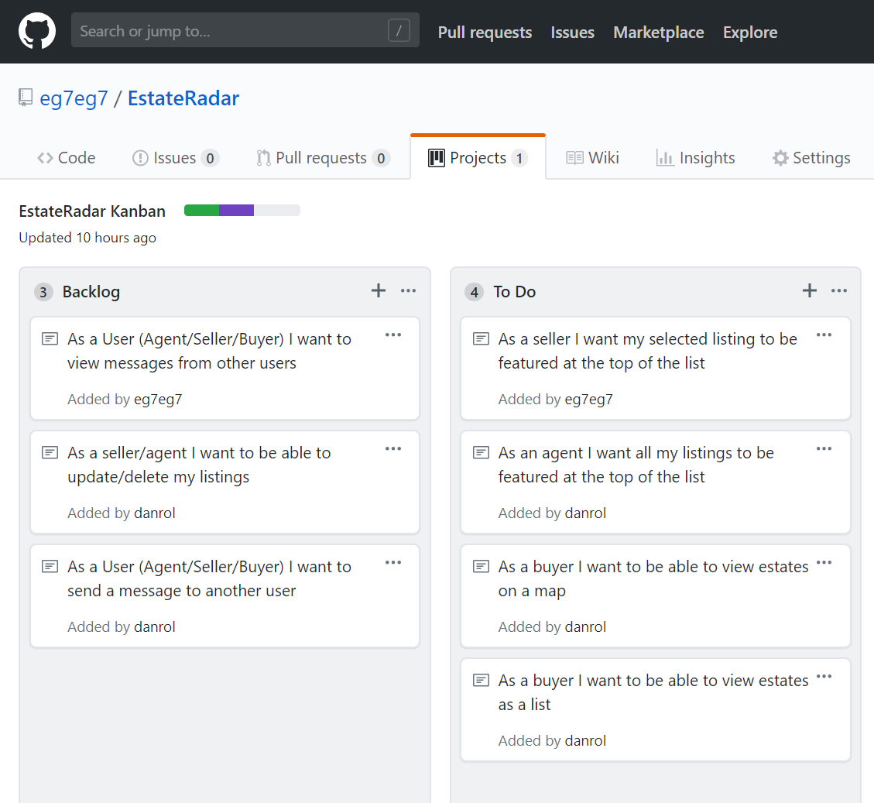
GitHub Kanban Link

Slide 15
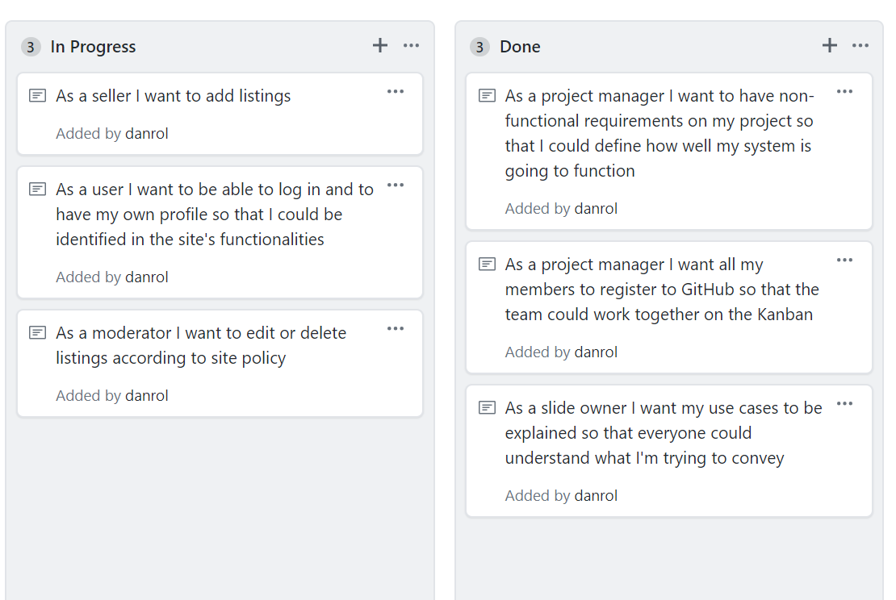

Slide 16
Kanban User Stories
As a buyer I want to be able to view estates on a map
As a buyer I want to be able to view estates as a list
As a User (Agent/Seller/Buyer) I want to send a message to another user
As a User (Agent/Seller/Buyer) I want to view messages from other users
As a User (Agent/Seller/Buyer) I want to view my messages
As a moderator I want to edit or delete listings according to site policy
As a seller/agent I want to be able to update/delete my listings
As a user I want to be able to log in and to have my own profile so that I could be identified in the site's functionalities
As an agent I want all my listings to be featured at the top of the list

Slide 17
Kanban User Stories
As a project manager I want to have non-functional requirements on my project so that I could define how well my system is going to function
As a project manager I want all my members to register to GitHub so that the team could work together on the Kanban
As a slide owner I want my use cases to be explained so that everyone could understand what I'm trying to convey
As a seller I want my selected listing to be featured at the top of the list
As a seller/agent I want to add listings

Slide 18

The word user is the word used by the computer professional when they mean “idiot”
Dave Barry
(Pulitzer Prize-winning American author and columnist)

Slide 19
Functional requirements

Slide 20
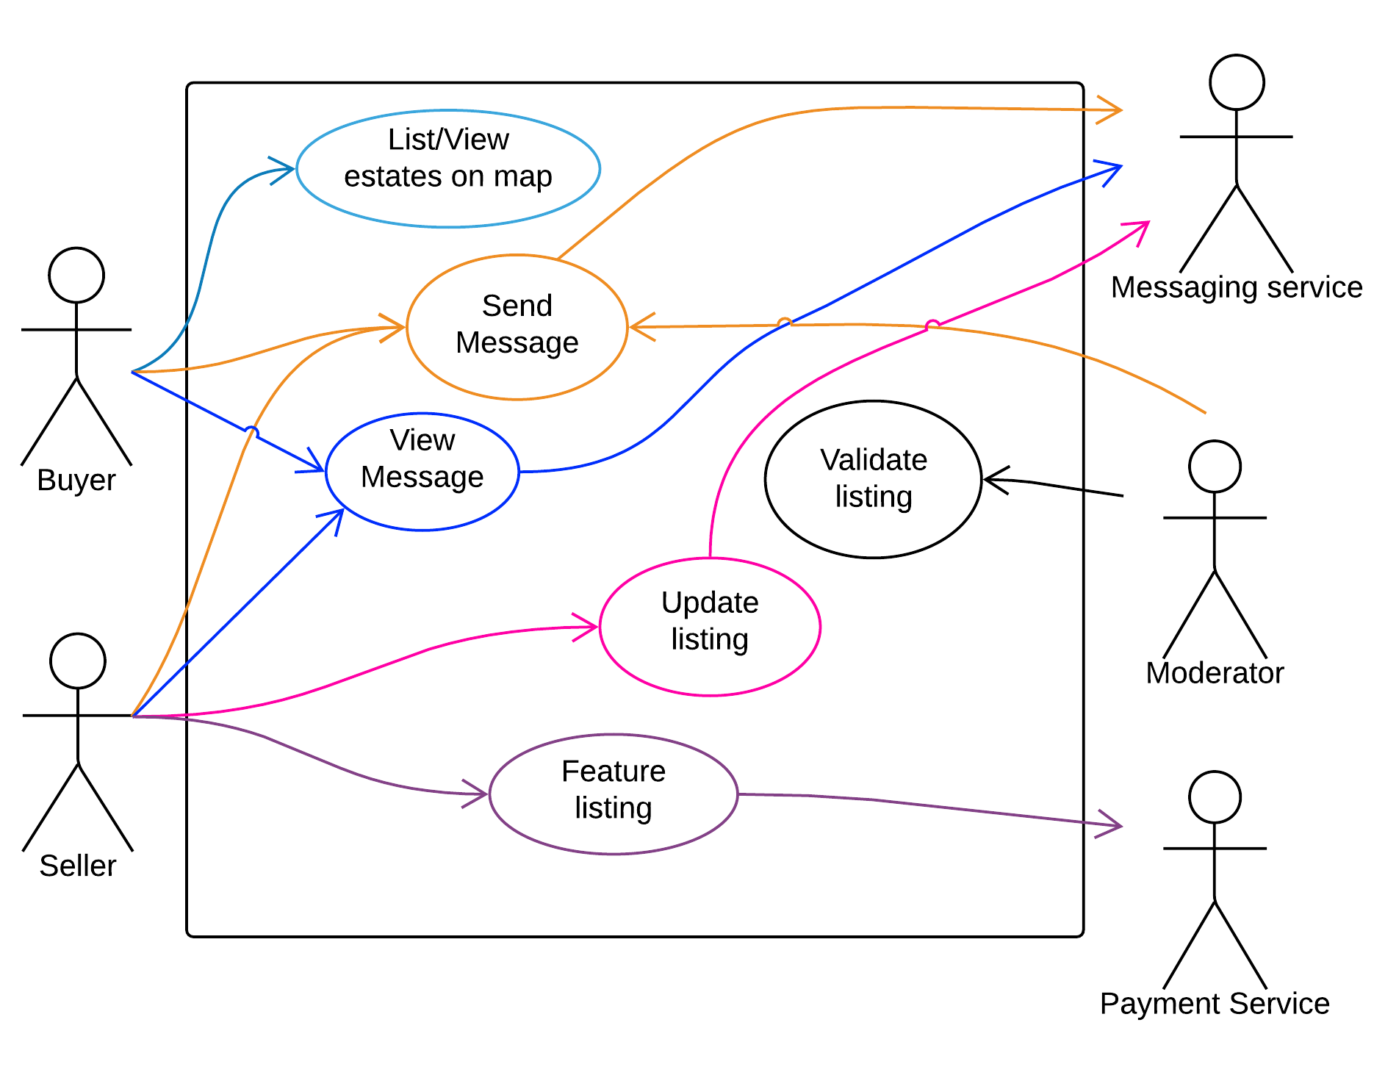
Use case diagram

Slide 21
Actors and goals
Actor | Primary/Secondary | Description | Goals
Buyer | Primary | A user that searches for an estate to buy/rent | Buy/rent an estate
Seller | Primary | A user that wants to sell/rent their asset | Sell/rent an estate
Payment Service | Secondary | External system to manage payments between the site and the user. | -
Moderator | Primary/Secondary (Depends on use case) | An employee that validates listings (new and updated) before publishing them | All listings on the site should meet the site’s policies
Messaging Service | Secondary | - | -

Slide 22
Use Cases
List/View Estates on map
Add/edit listing
Validate listing
Send Message
View Message
Feature Listing

Slide 23
Use case:
List/View estates on Map

Slide 24
List/View Estates on Map
Actors
Buyer (Primary)
Objectives
A potential buyer is able to view estates for sell/rent on a map and as listings.
Preconditions
Buyer should own a device with internet connection and web browser.
Device browser should meet the system requirements of the site’s technology.

Slide 25
Basic Flow - List/View Estates on Map
Buyer | System
Visits the website and enters their desired area to find potential estates.
 | Shows listings and marked estates on the map and as a listing

Slide 26
Alternate flow - List/View Estates on Map
Buyer | System
Visits the website and moves into area of their interest to find potential estates.
 | There are no estates listed in the desired area.
 | The listing view will be empty and there will be no estates on the map.

Slide 27
Use Case:
Update listing

Slide 28
Update listing
Actors
Seller (Primary)
Moderator (Secondary)
Objectives
Actors will be able to update a listing to provide the most accurate information about estates.
Preconditions
Seller must be the listing owner.
For a listing to be updated, the changes must be approved by a Moderator.

Slide 29
Basic Flow - Update listing
Seller | System | Moderator
Perform login
 | Verifies User’s data and allows login
Updates a listing
 | Saves a temporary version of the listing
 | System sends message to the Moderator of a new listing to validate.
 |  | Get the message from system and validate listing
 | Listing is updated successfully and new data is saved to the database

Slide 30
Alternate Flow - Update listing
Seller | System | Moderator
Perform login
 | Verifies User’s data and allows login
Updates a listing
 | Saves a temporary version of the listing to database for the moderator to review.
 | System sends message to the Moderator of a new listing to validate.
 |  | Gets the message from system and rejects the new update.
 |  | Sends message to user with the reason of rejection
 | Listing is not updated. User has to retry.

Slide 31
Use Case:
Validate Listing

Slide 32
Validate listing
Actors
Moderator (Primary)
Objectives
Review and approve listing updates.
Filter out spam messages and irrelevant details.
Make sure that the price is not too different than the rest of the listings within the area and of the same level.
Preconditions
Moderator is logged in.

Slide 33
Basic Flow - Validate listing
Moderator | System
Perform login
 | Verifies User’s data and allows login
Gets a message about new listings to approve.
Reviews new listings
Approves listing.
 | Listing is updated on the site.

Slide 34
Alternate Flow - Validate listing
Moderator | System
Perform login
 | Verifies Seller’s data and allows login
Gets a message about new listings to approve.
Reviews new listings
Moderator rejects listing.
Moderator sends a message to Seller with the reason of rejection.
 | Listing does not change until Seller won’t fix it.

Slide 35
Use case:
Send Message

Slide 36
Send Message
Actors
Buyer (Primary)
Seller (Primary)
Messaging Service (Secondary)
Objectives
A messaging system allows to user to send messages one to another
A messaging system in the site encourages clients to return to the site
Preconditions
User must be logged in to create message
Notes:
Preconditions:
Must have keyboard and Brains

Slide 37
Basic Flow - Send Message
User = Seller/Buyer
User | System | Messaging Service
Perform login
 | Verifies User’s data and allows login
Send message to another User
 | Transfer message to messaging service
 |  | Saves message for the recipient user to view later

Slide 38
Alternate Flow - Send Message
User = Seller/Buyer
User | System | Messaging Service
Perform login
 | Verifies User’s data and allows login
 |  | Service is not available
User is not able to send the message
 | Shows an error window saying to try again later

Slide 39
Use case:
View Message

Slide 40
View Message
Actors
Buyer (Primary)
Seller (Primary)
Messaging Service (Secondary)
Objectives
User is able to view all incoming/outgoing/sent messages
The possibility of viewing messages on the site encourages clients to return to the site to check for new messages
Preconditions
User must be logged in to view message
Messaging Service must be available
Notes:
Preconditions:
Must have keyboard and Brains

Slide 41
Basic Flow - View Message
User = Seller/Buyer
User | System | Messaging Service
Perform login
 | Verifies User’s data and allows login
 | Transfers user to Messaging Service
 |  | Shows all relevant messages
User views message

Slide 42
Alternate Flow - View Message
User = Seller/Buyer
User | System | Messaging Service
Perform login
 | Verifies User’s data and allows login
 | Transfers user to Messaging Service
 |  | There is no relevant messages to show
No messages to review

Slide 43
Use case:
Feature listing

Slide 44
Feature listing
Actors
Seller (Primary)
Payment Service (Secondary)
Objectives
Seller or agent receives more views for their published estates
because they will be featured on the top of the listing view.
Preconditions
Seller must be the listing owner.
Must pay to feature his listing

Slide 45
Basic Flow - Feature Listing
Seller | System | Payment Service
Perform login
 | Verifies the user’s data and allows login
Chooses a listing to feature and asks to pay for it with the payment service of his choice
 | Delegates care of payment to payment service with the amount needed to pay and user ID
 |  | Asks user for payment information.
User fills information onto the payment service
 |  | Notifies system that the money transfer was done successfully with the relevant ISO 8583 return code
 | Listing is featured in the listing view of the estates

Slide 46
Alternate Flow - Feature Listing
Seller | System | Payment Service
Perform login
 | Verifies User’s data and allows login
Chooses a listing to feature and asks to pay for it with the payment service of his choice
 | Delegates care of payment to payment service with the amount needed to pay and user ID
 |  | Asks user for payment information.
User fills information onto the payment service
 |  | Notifies System that there is a problem with payment with the relevant ISO 8583 return code
 | System asks user to try different payment option or to retry with valid information
User chooses the payment service of his choice and tries again

Slide 47
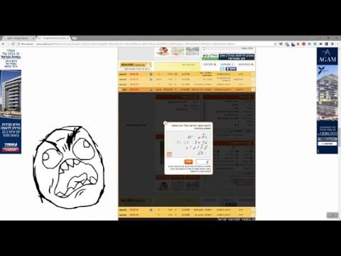

Slide 48
Thanks!
Any questions?

